Slide 1


SKIN DISEASE DETECTION USING VISION TRANSFORMERS
Real-Time Classification for Accessible Dermatological Care
Group -9 :
Abhigna Mallepally & Edwin Daniels
MSDSP 462 - COMPUTER VISION

Slide 2
EXECUTIVE SUMMARY
Application Purpose:
Develop an AI-powered application to deliver real-time skin condition classification, enhancing access to timely dermatological care.
Problem Statement:
How can we ensure timely and accurate preliminary diagnosis for people affected by skin conditions if they lack immediate access to a dermatologist?
Model Solution & Results:
Solution: We utilize a fine-tuned Google/ViT-base-patch16-224-in21k model leveraging transformer-based global feature extraction for superior classification performance.
Results: The ViT model demonstrated robust accuracy across training, validation, and test datasets, supporting effective preliminary assessments and integration into telemedicine workflows.
Application Purpose
Problem Statement
Model Solution and Results

Slide 3



PROJECT OVERVIEW
Objective
Skin conditions affect millions globally, requiring timely and accurate diagnosis.
Many individuals lack immediate access to dermatologists, leading to delays in diagnosis.
Therefore, we aim to build an AI- powered edge application to classify diverse skin conditions and provide real-time preliminary assessment.
Benefits
Faster diagnosis
Improved access to dermatological care
Potential integration with telemedicine.
Challenges
Variability in skin conditions across demographics
Model accuracy and generalisation
Differentiating between similar looking conditions
User photos may vary

Slide 4

PROJECT WORKFLOW
📱User Uploads/Captures Image
(Streamlit App)
Image Preprocessing
🧠 Deep Learning Model
📊Prediction (Skin Condition + Confidence Score)
✅ Diagnosis & Next Steps
Tech Stack
Programming Language: Python
Packages: OpenCV, PIL, TensorFlow/Keras, PyTorch, ONNX, Ultralytics
TensorFlow Lite
Edge Deployment: Streamlit (for app interface)

Slide 5

DATA OVERVIEW
HuggingFace DermNet dataset
Source: https://huggingface.co/datasets/Muzmmillcoste/dermnet/viewer
Data: 13.2K train and 2.33K test images (85/15 split)
Classes: 23 classes of skin conditions
Format: RGB images in JPEG format
Data Preparation:
Label Encoding: Converted categorical labels to numerical format for model compatibility.
Data Splitting: Split the 13.2k images of training data (75: 25) for train and validation sets.

Slide 6
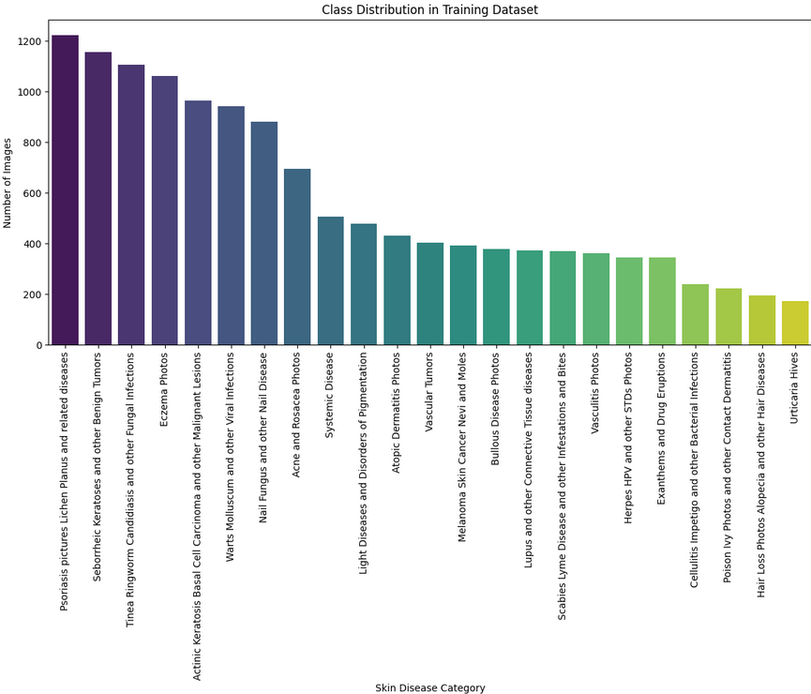
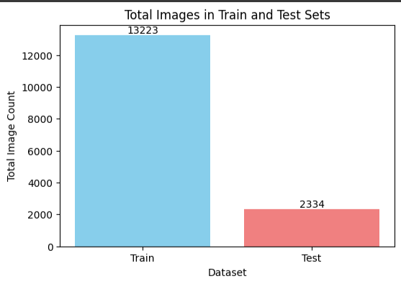
DATA EXPLORATION
The dataset is not well balanced. The top five classes are focused on Psoriasis, Seborrheic Keratoses, Fungal infections, Eczema, Malignant lesions.

Slide 7
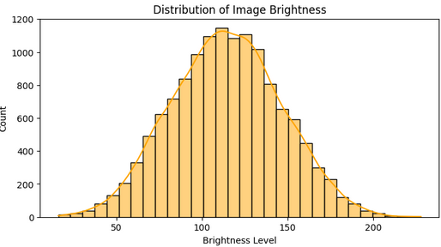
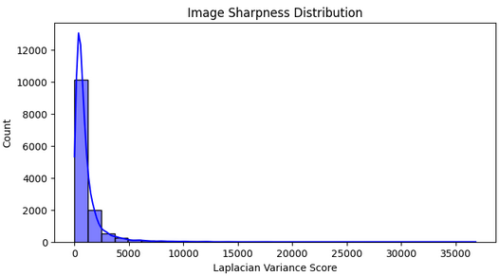
EDA – IMAGE DATA
Brightness is Normally Distributed – Most images have brightness values between 100-1, indicating consistent lighting
Sharpness Distribution is Right-Skewed – Some images are very sharp, while others are blurry which may impact model feature extraction.
Red Color Bias in Images – Higher red (mean R = 0.54), shows that skin conditions are captured with more red intensity, compared to blue and green.
Moderate Color Variability – Standard deviation across RGB channels is acceptable showing no extreme shifts in color, but normalization may still improve model performance.
✅ Mean RGB Values: [0.54151905 0.4143129 0.38259336]
✅ Standard Deviation RGB Values: [0.1931299 0.16628343 0.16067074]

Slide 8
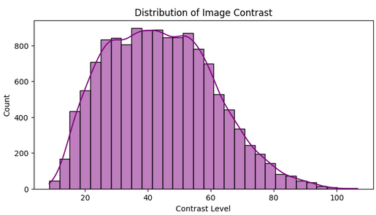
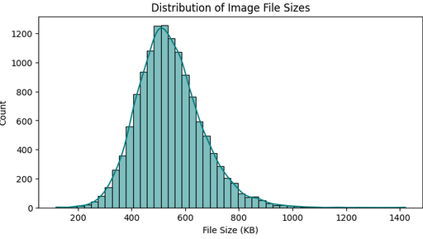
EDA – IMAGE DATA
Contrast is slightly right-skewed distribution– most images have moderate contrast (between 30 to 60), with few high-contrast images.
Normal Distribution of image file sizes (in KB): Shows a peak around 500 KB, indicating that most images fall within this range. Fewer images have significantly larger file sizes, with a long tail extending beyond 800 KB.

Slide 9
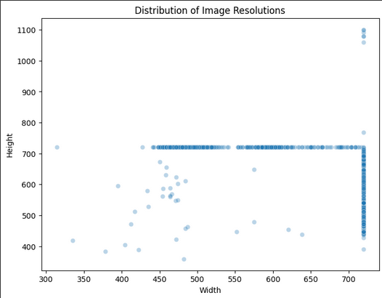
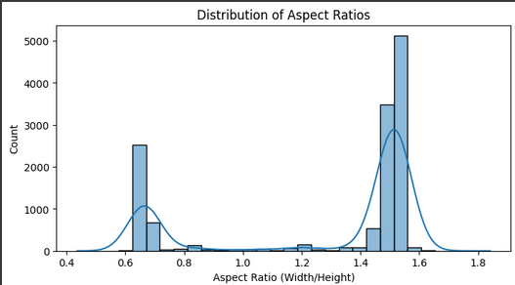
EDA – IMAGE DATA
Key Observations
Class Imbalance in Dataset (Model Bias towards certain skin conditions) Solution: Data Augmentation
Some Conditions Look Very Similar (Misclassification Risk)
Solution: Fine-tune pre-trained models and hyper-parameter tuning
Image Quality & Resolution Variability detected (impacts accuracy)
Solution: resize images to ensure uniform model input
Known fact: Dataset Contains More Light-Skinned Samples (Bias Risk)
There is a high degree of variability in image size and two main classes of aspect ratios (portrait/landscape).

Slide 10

DATA PRE-PROCESSING
Image Pre-processing:
Resizing: Standardize image dimensions for model input (224 x 224).
Rescaling: Scale the pixel values by a factor of 1/255.
Normalization: Scale the pixel values (-1 to 1) using mean and s.d of 0.5.
Resampling: Uses method 2 (bilinear interpolation) for resizing consistency
Data Augmentation (For Training Only):
Flipping & Rotation: Random horizontal flips and rotations to improve generalization.
Cropping & Scaling: Simulate different viewing conditions while maintaining aspect ratio.
Brightness & Contrast Adjustments: Adjust brightness and contrast to handle lighting variations
Image adjustments
Data Augmentation
Label Encoding
Data Loading & Batching:
Convert images to tensors using PyTorch DataLoader or TensorFlow Dataset API.
Optimize with batch size, shuffling, and prefetching for performance.
Processed Data

Slide 11
METHODOLOGY: MODELS & APPROACH (1/2)
Architecture: A lightweight evolution in the YOLO family, optimized for real-time detection and classification.
Why this model?
Balances lightweight design with high-accuracy, ideal for deployment in resource-constrained environments.
Fast inference speed, suitable for real-time lesion analysis.
Can detect multiple skin conditions in a single image, useful for complex cases with multiple lesions.
Can be fine-tuned for classification tasks, even when bounding boxes aren’t required.
Architecture: Utilizes depth-wise separable convolutions and inverted residuals with linear bottlenecks to minimize computational cost and model size.
Why this model?
Optimized for mobile and edge devices, making it ideal for mobile-based skin disease classification.
Works efficiently with small datasets by leveraging pre-trained ImageNet weights.
Captures essential texture and shape patterns, crucial for differentiating skin conditions.
Delivers a strong trade-off between model size and accuracy, making it suitable for applications with limited resources.
YOLO (YOLOv8n-cls)
Facebook/DINOv2
MobileNetV2
Architecture: A self-supervised ViT-based model trained using contrastive loss. It learns without labeled data to build robust and transferable visual representations.
Why this model?
With high parameter count (~1 Billion), it captures long-range dependencies and relationships between pixels.
Generalizes well across datasets with minimal labeled data, making it ideal for medical imaging.
Distinguishes subtle color, texture, and lesion morphology variations, essential for skin disease classification.

Slide 12
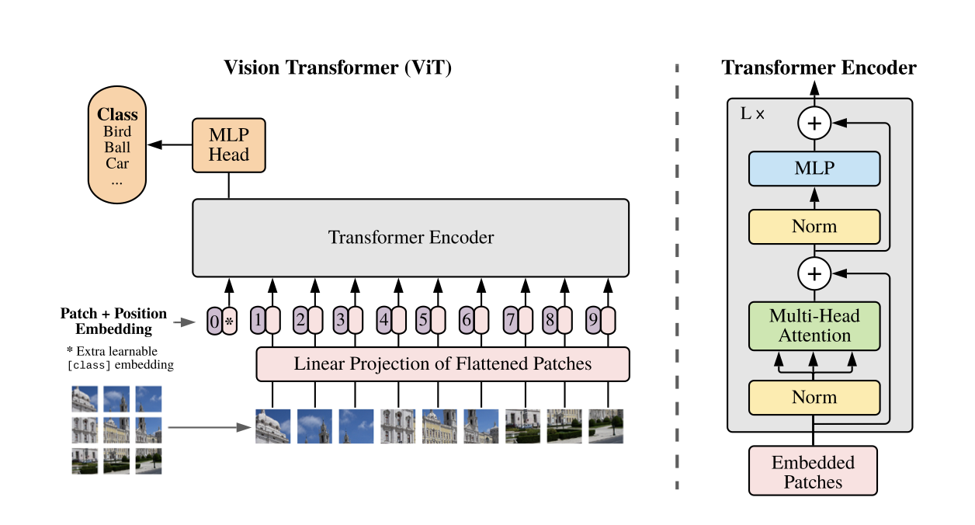
METHODOLOGY: MODELS & APPROACH (2/2)
google/vit-base-patch16-224-in21k
Output: The class token representation is passed through a linear layer (and sometimes additional normalization layers) to produce the final predictions.
Multi-Head Self-Attention: This mechanism enables the model to capture relationships between all patches, allowing it to understand global context across the image.
Feed-Forward Neural Networks (MLP): Each attention block is followed by a multi-layer perceptron that further processes the information.
Normalization & Residual Connections: Layer normalization and residual connections help stabilize and improve training.
Class Token: A special token (similar to the [CLS] token in language models) is prepended to the sequence of patch embeddings. After processing through the transformer layers, the final representation of this token is used for classification.
Takes in 224 x 224 images and divides into patches of 16x16 for the patch sequence 196 patches (14 x14)
Each patch is flattened into a 1D vector. These vectors are then projected linearly into a fixed-size embedding space. This projection step is analogous to word embeddings in NLP
Source:
Dosovitskiy, Alexey, Lucas Beyer, et al. 2020. “An Image is Worth 16x16 Words: Transformers for Image Recognition at Scale.” arXiv preprint arXiv:2010.11929. https://arxiv.org/abs/2010.11929.

Slide 13

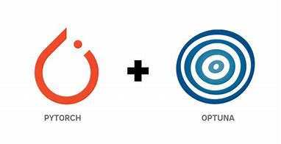





METHODOLOGY: SOLUTION ARCHITECTURE
Data Sourcing
Model Development
load_dataset("Muzmmillcoste/dermnet")
Image pre-processing & augmentation
Google’s pre-trained transformer model
vit-base-patch-16-224-in21k
Torchvision.transforms
RandomResizedCrop
RandomHorizontalFlip
Resize
CenterCrop
ToTensor
Normalize
Convert to edge framework
OR
Deployment for predictions
AutoImageProcessor
Predictions +
Confidence Score

Slide 14
RESULTS & KEY FINDINGS (1/2)
Model | Type | Parameters | Training Time (A100 GPU) | Training Accuracy | Validation Accuracy | Test Accuracy | Key Features
MobileNetV2 | CNN | 3.05M | ± 25 mins on (10 epochs) | 50.35% | 43.10% | 56.14% | Lightweight, efficient for mobile/edge. Requires extensive tuning to improve performance
YOLOv8 (YOLOv8n-cls) | CNN (Object Detection & Classification) | ~1.47M | ± 20 min on (10 epochs) | 50.76% | 44.92% | 48.20% | Optimized for real-time detection
Facebook/DINOv2-base (Vision Transformer) | Vision-based Transformer | 1 Billion | ± 30 mins on (10 epochs) | 83.45% | 67.35% | 64.87% | Self-supervised learning, robust representations
Google/VIT-base-patch-16-224-in21K | Vision-based Transformer | 86.6 M | ± 20 mins on (10 epochs) | 92.56% | 96.88% | 96.99% | Pretrained on ImageNet-21K, and finetuned on DermNet - strong performance on various vision tasks

Slide 15
RESULTS & KEY FINDINGS (2/2)
The Google VIT, finetuned on DermNet data, showed the best performance across train, validation and test splits.
The self-attention mechanism captures global context, effectively handling complex skin patterns.
Data augmentation and pre-processing helped address class imbalance, image quality variability, and potential bias (e.g., overrepresentation of light-skinned samples).
Compared with other architectures, ViT demonstrated superior accuracy for skin condition classification
From the literature review and experimentation, we understood that computational power is key for large model hyperparameter tuning as it greatly reduces the training time

Slide 16
LITERATURE REVIEW
Recent advancements in deep learning for skin disease classification have demonstrated the effectiveness of CNNs, real-time object detection models, and vision transformers:
MobileNetV2 has been widely adopted in edge AI applications due to its efficient architecture. Its use in dermatology has shown promising results in low-resource environments, where mobile-based screening tools are necessary.
YOLOv8 is primarily known for object detection, but recent studies suggest its classification version (YOLOv8n-cls) can achieve high-speed, real-time inference while maintaining accuracy, making it suitable for skin lesion analysis.
Facebook’s DINOv2 Vision Transformer has been applied successfully in medical imaging tasks. According to Mohan et al. (2024), DINOv2 achieved 96.48% accuracy and 0.9727 F1-score on a dataset of 31 skin disease classes. Additionally, Oquab et al. (2023) highlighted DINOv2’s ability to capture subtle differences in lesion morphology, making it a valuable model for dermatology.
Google/VIT-base-patch-16-224-in21K has shown strong performance in medical imaging tasks due to its global feature extraction capabilities. By pretraining on ImageNet-21K and fine-tuning on DermNet, it achieves robust classification performance.

Slide 17
REFERENCES
Dermnet. “Dermatology Image Dataset.” Accessed March 16, 2025. https://dermnetnz.org/dermatology-image-dataset.
McDonald, Kate. “HiNZ 2017: DermNet using AI for skin disease image recognition tool.” Pulse IT. Accessed March 16, 2025. https://www.pulseit.news/new-zealand-digital-health/hinz-2017-dermnet-using-ai-for-skin-disease-image-recognition-tool/.
Liopyris, Konstantinos, Stamatios Gregoriou, Julia Dias, and Alexandros J. Stratigos. 2023. “Artificial Intelligence in Dermatology: Challenges and Perspectives.” PubMed Central. Accessed March 16, 2025. https://pmc.ncbi.nlm.nih.gov/articles/PMC9674813/.
Dosovitskiy, Alexey, Lucas Beyer, et al. 2020. “An Image is Worth 16x16 Words: Transformers for Image Recognition at Scale.” arXiv preprint arXiv:2010.11929. https://arxiv.org/abs/2010.11929.
Oquab, Maxime, Timothée Darcet, et al. 2023. “DINOv2: Learning Robust Visual Features without Supervision.” arXiv preprint arXiv:2304.07193. https://arxiv.org/abs/2304.07193.
RoboFlow. “What Is YOLOv8? A Complete Guide.” Roboflow Blog. Accessed March 16, 2025. https://blog.roboflow.com/what-is-yolov8/.
Mohan, Jayanth, Arrun Sivasubramanian, Sowmya V, and Vinayakumar Ravi. 2024. “Enhancing Skin Disease Classification Leveraging Transformer-based Deep Learning Architectures and Explainable AI.” arXiv preprintarXiv:2407.14757. https://arxiv.org/pdf/2407.14757.
Miętkiewicz, Łukasz, Leon Ciechanowski, and Dariusz Jemielniak. "The Skin Game: Revolutionizing Standards for AI Dermatology Model Comparison." arXiv preprint arXiv:2502.02500 (2025). https://arxiv.org/pdf/2502.02500

Slide 18
NEXT STEPS/PATHS TO MVP
Data Expansion: Train the model on normal skin samples across diverse races to further reduce bias (limit false positives on normal skin)
Explainability Integration: Incorporate tools like GradCAM and SHAP to provide interpretability and build trust in AI predictions.
Rigorous External Validation: Validate on broader, external datasets to ensure generalization and continuous performance monitoring (e.g. SCIN and HAM 10000)
Mobile Deployment: Integrate ONNX Runtime Mobile to enable efficient on-device inference, ensuring offline functionality and a smooth user experience on both iOS and Android.
User Interface Development: Create an intuitive, mobile-friendly interface with real-time predictions and potential telemedicine integration.

Slide 19
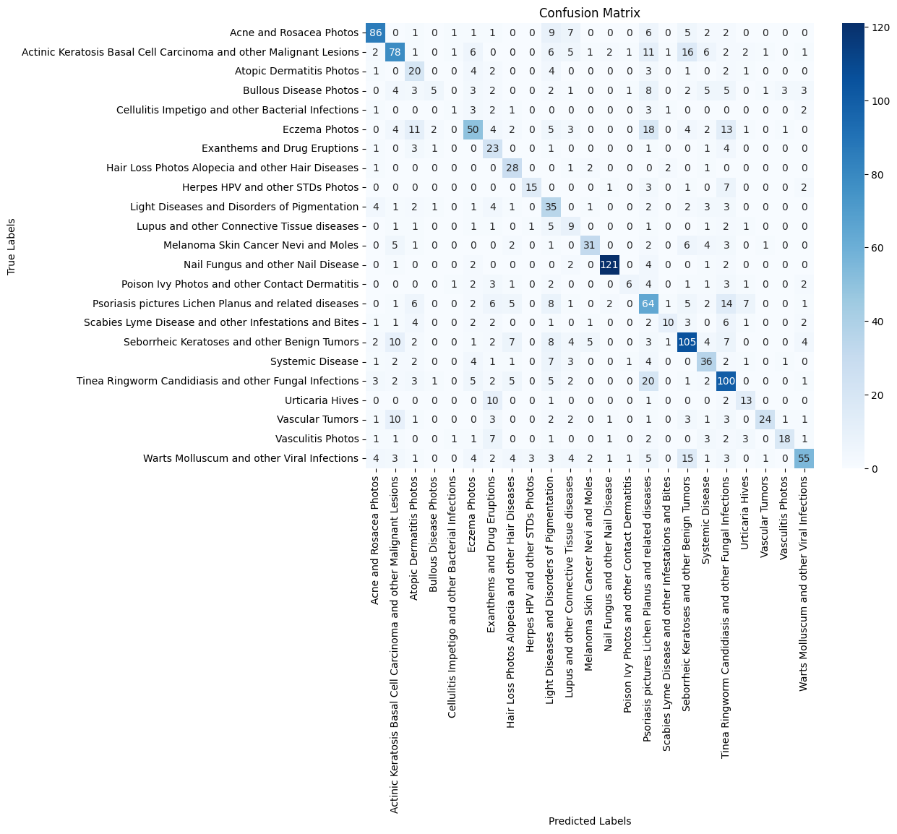
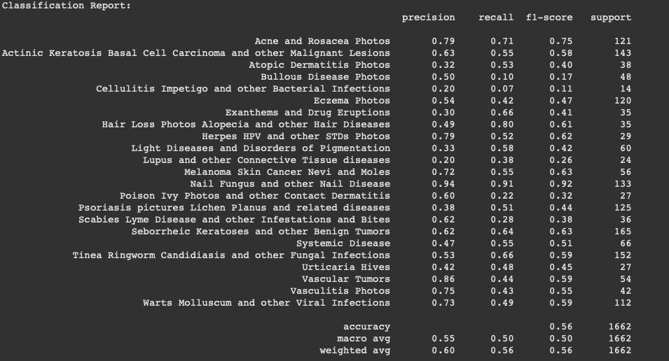
APPENDIX
MobileNetV2 - Confusion Matrix and Classification Report

Slide 20
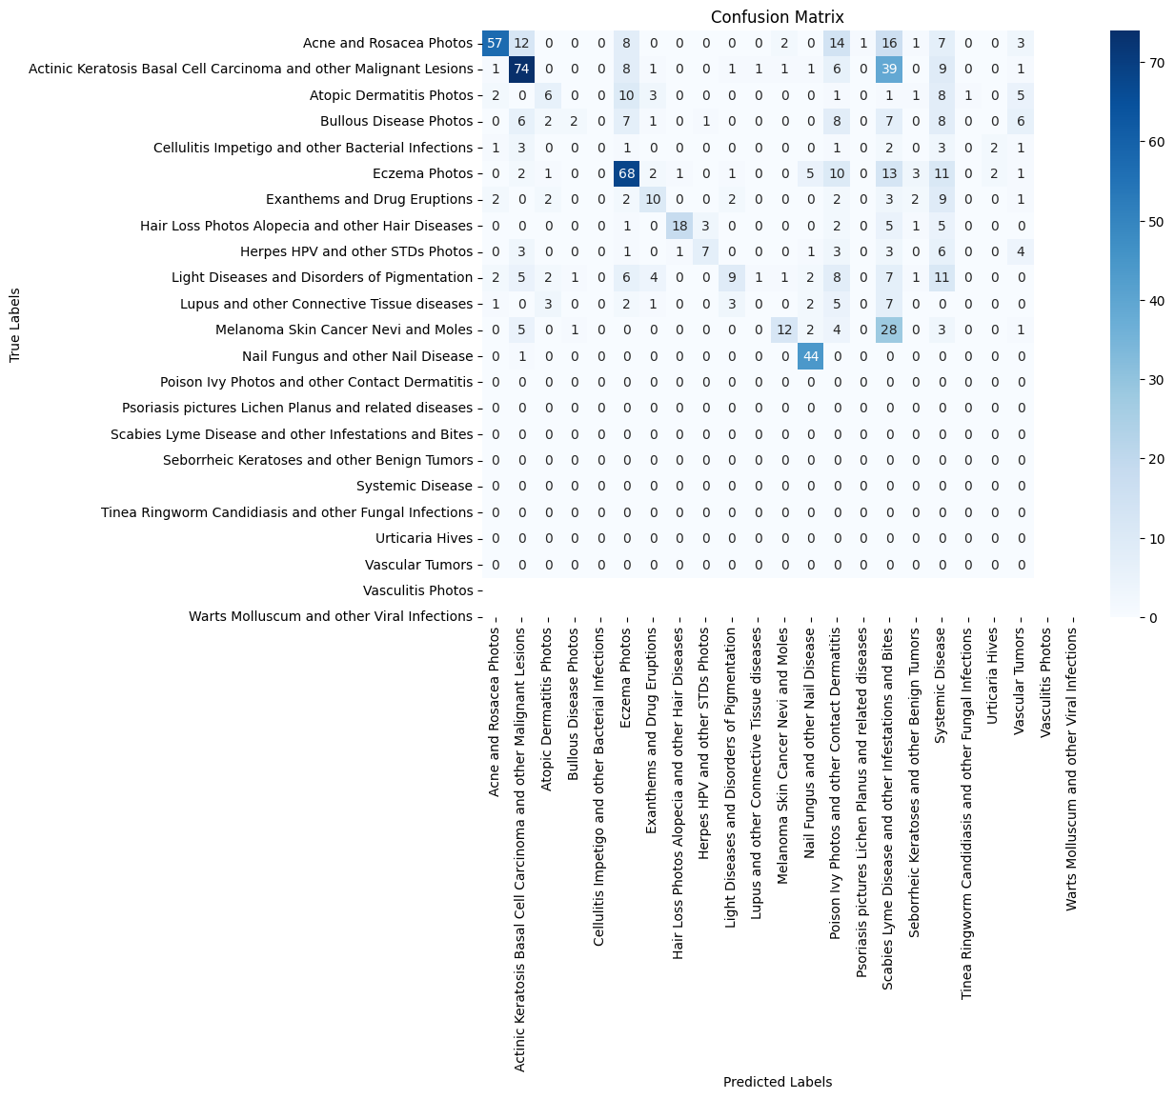
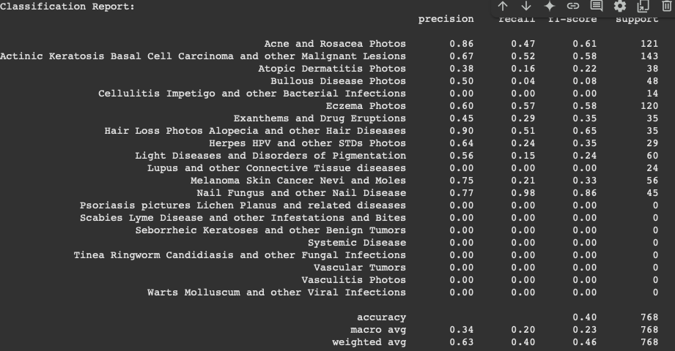
APPENDIX
YOLOv8 - Confusion matrix and classification report

Slide 21

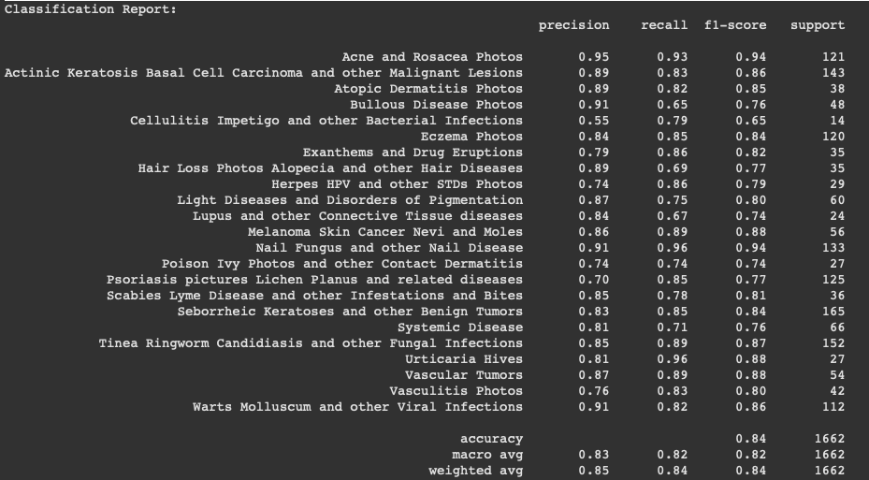
APPENDIX
Facebook DINO v2 finetuned base model - Confusion Matrix and Classification Report

Slide 22
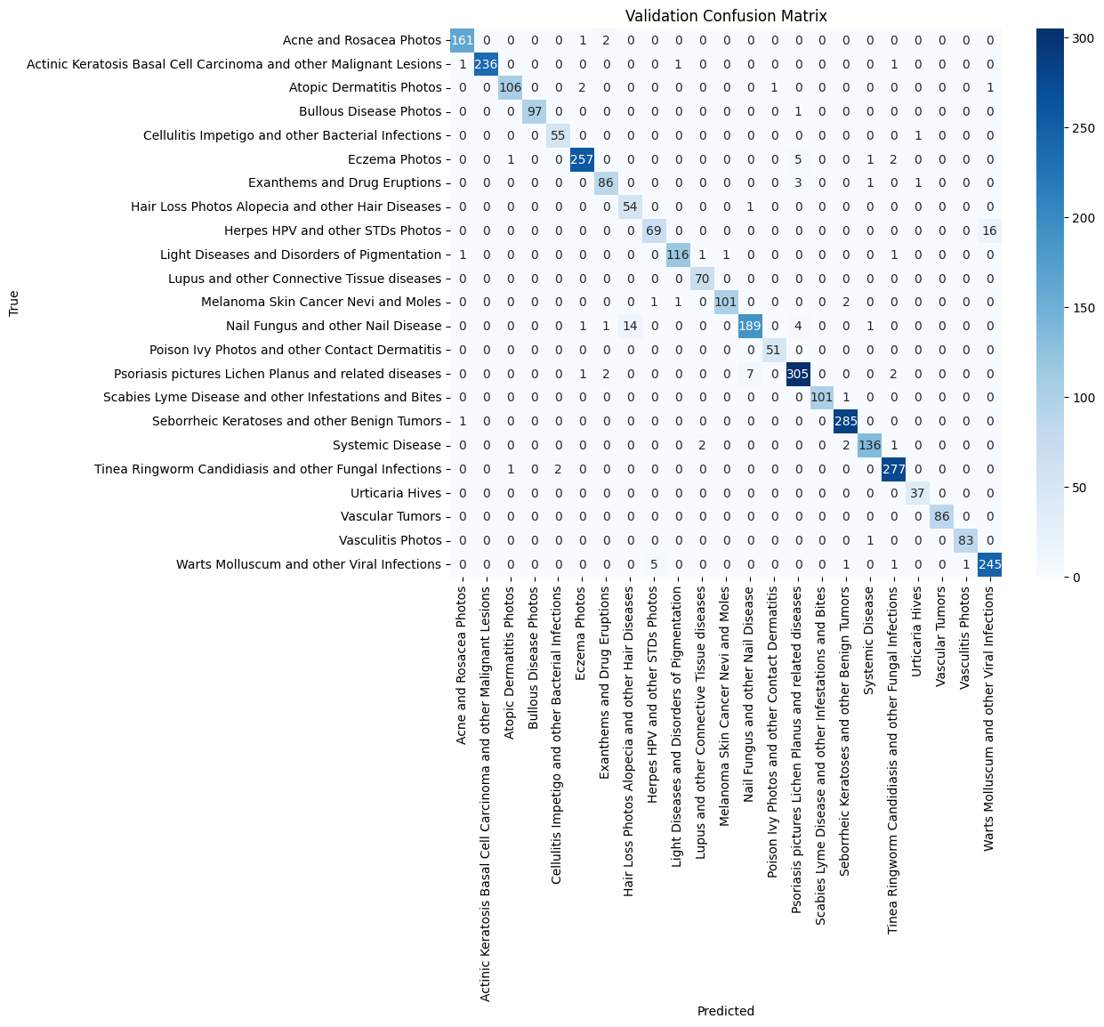
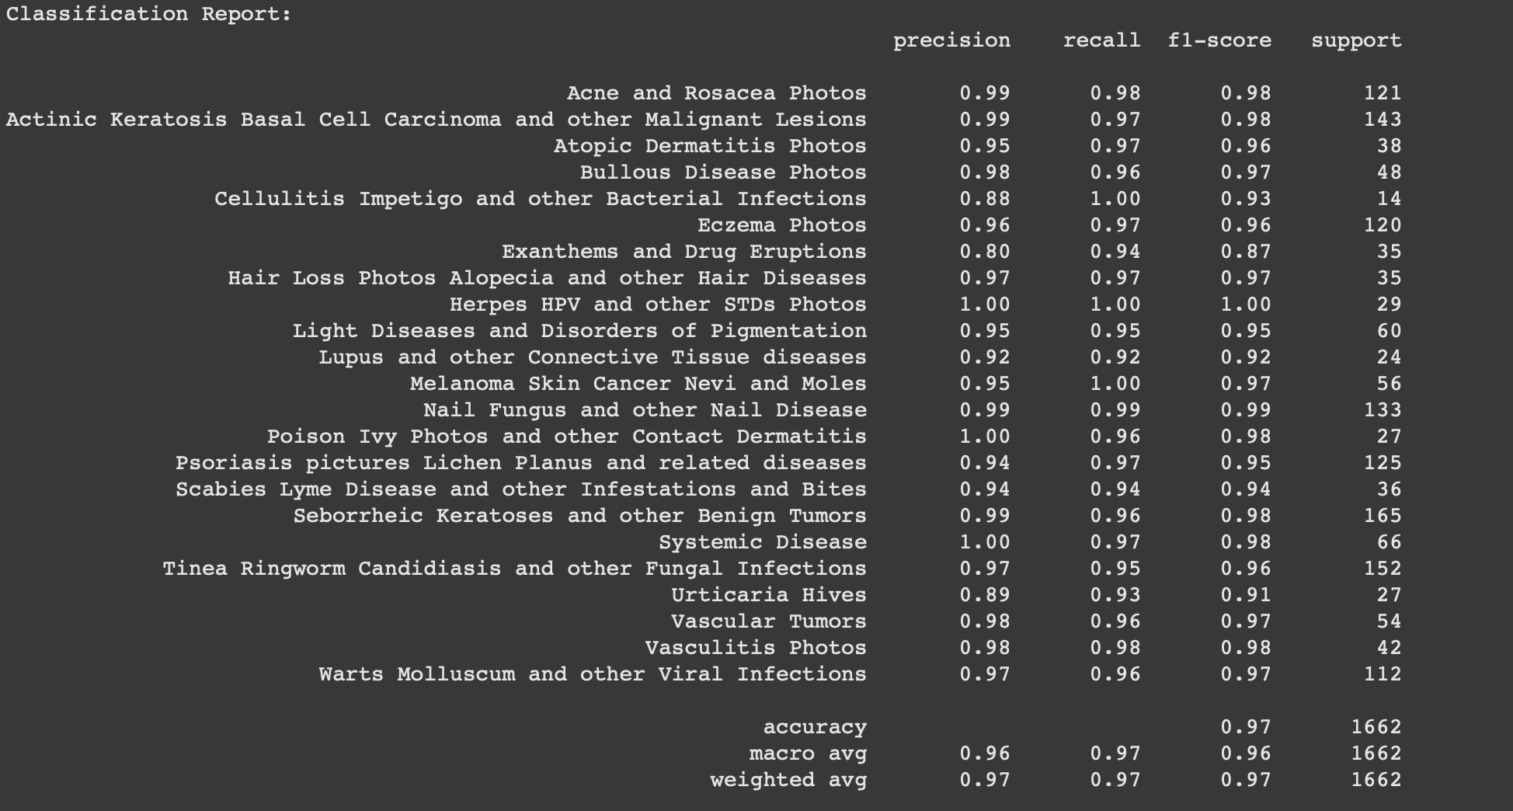
APPENDIX
Google’s VIT-base model - Confusion Matrix and Classification Report

Slide 23
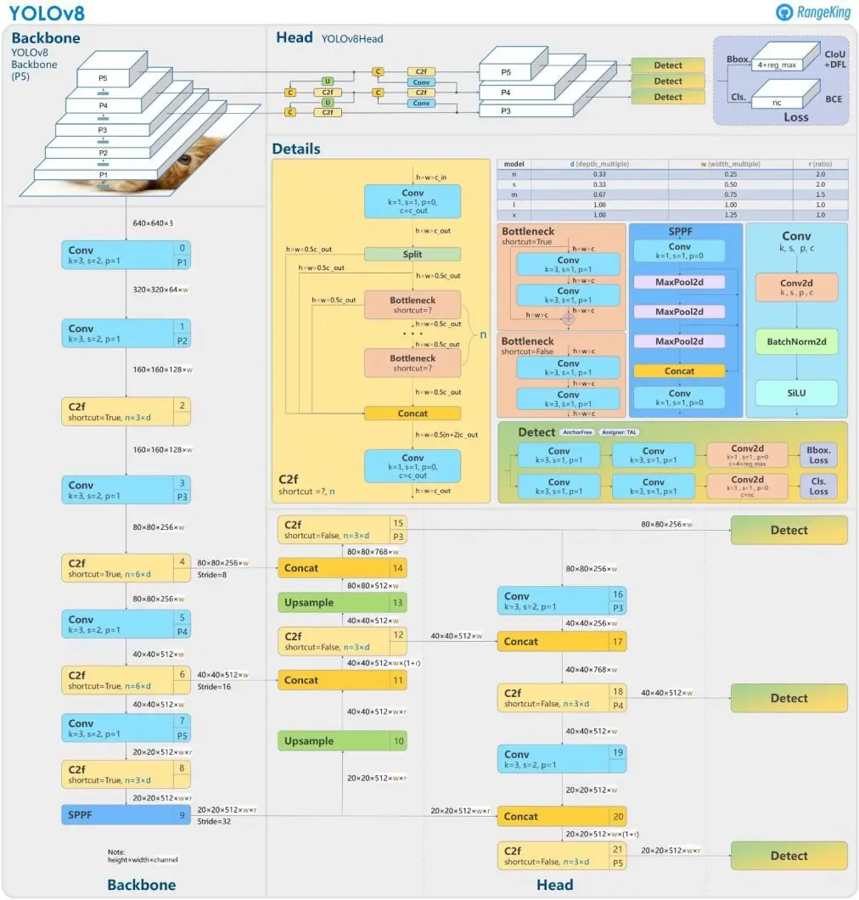
APPENDIX
YOLOv8 Architecture

Slide 24
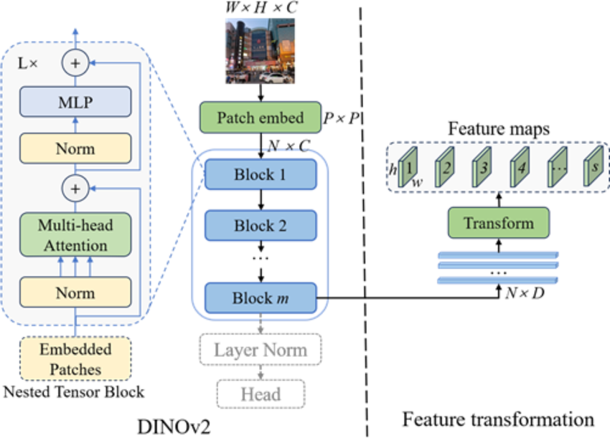
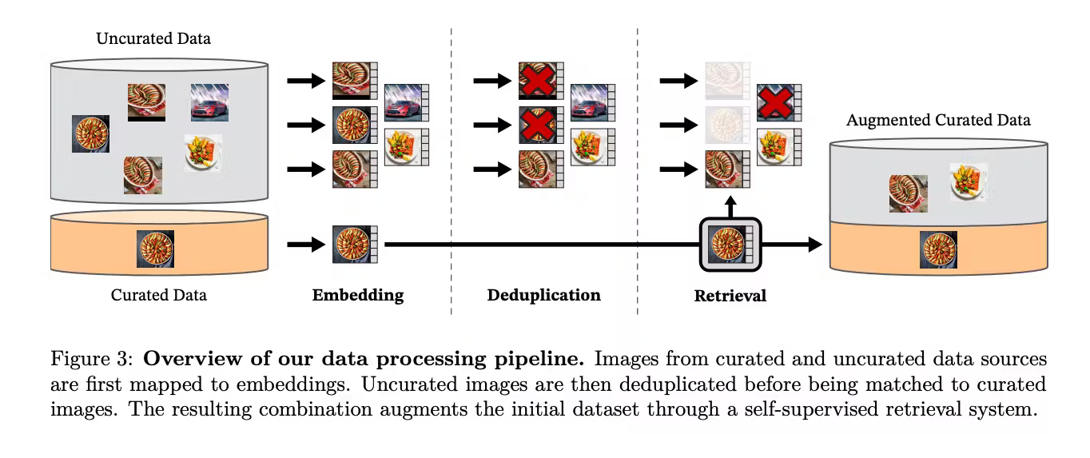
APPENDIX
DINOv2

Slide 25
THANK YOU

